Slide 1
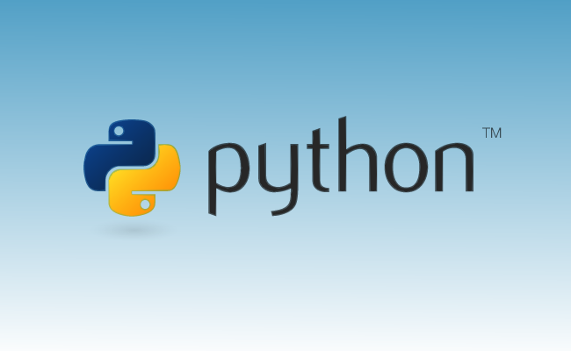
Info-6079 Security Application
Week 2 – Loops, Sequences

Slide 2
Lecture will cover
Sequences
String (review), list, and tuples
Dictionary: Mapping type
Sets
Loops
For loop
While loop
MATCH Statement
If Statements
Catching exceptions
Functions
Build-in: come within python
Build your own
Import & Modules

Slide 3
Are ordered sets of objects with an index of non-negative integers.
Sequences:
Notes:
There are eight built in types in Python that are sequences:
string
list
tuple
bytes
bytearray
buffer
array.array
range object (almost)
Out of these seven, three are the most popular.
These three are: –
Lists
Tuples
Strings

Slide 4
String
As we saw last week:
Street_address = “1001 Fanshawe College Blvd.”
Could use double quotes “” or single quotes ‘’
Use triple quotes “”” or ‘’’ for writing multiline strings
long_string = “’A string that last multiple lines, just like this one.’”
Notes:
How to create a string in Python?
Strings can be created by enclosing characters inside a single quote or double-quotes.
Even triple quotes can be used in Python but generally used to represent multiline strings and docstrings.
# defining strings in Python
# all of the following are equivalent
my_string = 'Hello’
print(my_string)
my_string = "Hello“
print(my_string)
my_string = '''Hello'‘’
print(my_string)
# triple quotes string can extend multiple lines
my_string = """Hello, welcome to the world of Python"""
print(my_string)

Slide 5
String
Test_string = “This is a test string”
print(test_string[0])
Will print: T
print(test_string[20])
Will print: g
Printing from end use negative numbers
print(test_string[-1] will print: g
Print(test_string[-4] will print: r
Notes:
How to access characters in a string?
We can access individual characters using indexing and a range of characters using slicing. Index starts from 0.
Trying to access a character out of index range will raise an IndexError.
The index must be an integer.
We can't use floats or other types, this will result into TypeError.
Python allows negative indexing for its sequences.
The index of -1 refers to the last item, -2 to the second last item and so on.

Slide 6
String
Concatenation of Two or More Strings
Joining of two or more strings into a single one is called concatenation.
The + operator does this in Python. Simply writing two string literals together also concatenates them.
The * operator can be used to repeat the string for a given number of times.
Notes:
# Python String Operations
str1 = 'Hello’
str2 ='World!’
# using +
print('str1 + str2 = ', str1 + str2)
# using *
print('str1 * 3 =', str1 * 3)
When we run the above program, we get the following output:
str1 + str2 = HelloWorld!
str1 * 3 = HelloHelloHello
Writing two string literals together also concatenates them like + operator.
If we want to concatenate strings in different lines, we can use parentheses.
>>> # two string literals together >>> 'Hello ''World!' 'Hello World!' >>> # using parentheses >>> s = ('Hello ' ... 'World') >>> s 'Hello World'

Slide 7
String
Test_string = “This is a test string”
print(test_string[5:9]) will print: is a
Prints from first number and stops one before second number.
Make sure the numbers are less than string length.
Use len(Test_string) to know the length of the string which is 21.
Notes:
Len is a method that gives the length of Sequences, strings, Lists, and Tuples.
Other common methods are min and max to show the minimum and maximum objects.
Slicing can be best visualized by considering the index to be between the elements as shown below.
If we want to access a range, we need the index that will slice the portion from the string.

Slide 8
How to split a string?
string.split(separator, max)
Separator: optional, specifies the separator, default is a whitespace
Max: optional, specifies how many splits, default is -1 for all occurrences
Split() method splits a string into a list
Could use it to separate IP Octets
ip_address = “10.0.0.1”
ip_octs = ip_address.split(".")
Ip_octs is a list filled with the four octets
Notes:
Slicing can be best visualized by considering the index to be between the elements as shown below.
Split a string into a list where each word is a list item:
txt = "welcome to the jungle" x = txt.split() print(x)
Example
Split the string, using comma, followed by a space, as a separator:
txt = "hello, my name is Peter, I am 26 years old" x = txt.split(", “) print(x)
Example
Use a hash character as a separator:
txt = "apple#banana#cherry#orange" x = txt.split("#") print(x)
Example
Split the string into a list with max 2 items:
txt = "apple#banana#cherry#orange" # setting the maxsplit parameter to 1, will return a list with 2 elements 0, 1 x = txt.split("#", 1) print(x)

Slide 9
Python Trim String Example | rstrip(), lstrip(), strip()
Python lstrip() function removes only leading whitespace chars.
Python rstrip() function removes only trailing whitespace chars.
Python strip() function removes specific whitespace chars
for example: myString.strip(‘\n’) or myString.lstrip(‘\n\r’) or myString.rstrip(‘\n\t’) and so on.
white spaces and leading and trailing spaces from Python string.
Notes:
# app.py
data = ' AppDividend ‘
print(data)
print('After Stripped Data’)
print(data.strip())
Now, let’s pass the parameter and see the output.
# app.py
data = 'AppDividend’
print(data)
print('After Stripped d character') print(data.strip('d'))

Slide 10
List
Lists can be created by enclosing objects in square brackets, “[“ and “]”.
Also indexed by non-zero integers that start with zero (0).
The value of lists are retrieved by referencing the number of an index.
Notes:
How to create a list?
In Python programming, a list is created by placing all the items (elements) inside square brackets [], separated by commas.
It can have any number of items and they may be of different types (integer, float, string etc.).
# empty list
my_list = []
# list of integers
my_list = [1, 2, 3]
# list with mixed data types
my_list = [1, "Hello", 3.4]

Slide 11
List
Router_Vendors = [“Cisco”, “Juniper”, “Nokia”]
print[0]
Will print: Cisco
print[1]
Will print: Juniper
print[2]
Will print: Nokia

Slide 12
List common methods
Router_names = [“r1”, “r2”, “r4”]
Router_names.append(“r5”)
Will be [‘r1’, ‘r2’, ‘r4’, ‘r5’]
Router_names.insert(2, ‘r3’)
Will be [‘r1’, ‘r2’, ‘r3’, ‘r4’, ‘r5’]
Router_names.pop(1)
Will be [‘r1’, ‘r3’, ‘r4’, ‘r5’]
Notes:
Python List Methods
append() - Add an element to the end of the list
extend() - Add all elements of a list to the another list
insert() - Insert an item at the defined index
remove() - Removes an item from the list
pop() - Removes and returns an element at the given index
clear() - Removes all items from the list
index() - Returns the index of the first matched item
count() - Returns the count of the number of items passed as an argument
sort() - Sort items in a list in ascending order
reverse() - Reverse the order of items in the list
copy() - Returns a shallow copy of the list

Slide 13
Tuples
Similar to list created by enclosing objects in parentheses, “(“ and “)”.
Also indexed by non-zero integers that start with zero (0).
Unlike lists, values cannot be modified after creation.
Datacenter = (“TorDB1”, “TorDB2”, “LonDB”)
Datacenter[1] will give you: TorDB2
Notes:
A tuple is a sequence of immutable Python objects. Tuples are sequences, just like lists.
The differences between tuples and lists are, the
tuples cannot be changed unlike lists and
tuples use parentheses(),
whereas lists use square brackets. []
Creating a tuple is as simple as putting different comma-separated values.
The parentheses are optional, however, it is a good practice to use them.
A tuple can have any number of items and they may be of different types (integer, float, list, string, etc.).
Unpack Tuples:
tup = (4, 5, 6)
a, b, c =tup
This will result in a =4, b = 5, and c = 6

Slide 14
How to remove object from Tuples
DBs = (“TorDB1”, “TorDB2”, “LonDB1”, “LonDB2”, “MonDB1”)
Option1:
DBs = DBs[:2] + DBs[3:]
DBs will become: TorDB1, TorDB2, LonDB2, MonDB1
Option2:
ListDB = list(DBs)
ListDB.remove(“TorDB2”)
DBs = tuple(ListDB)
DBs will become: TorDB1, LonDB2, MonDB1
Notes:
In option 1: the DBs[:2]
means take DBs[0] and DBs[1] and DBs[3:]
take everything from DBs[3] to the end.
Taking into account the colons.
Option 2 is
casting the Tuple to a list
editing the list
turning the edit list to a tuple

Slide 15
Contains objects that can be indexed by keys. Referred as the associated array or hashing table in other languages. Python dictionary is an unordered collection of items. While other compound data types have only value as an element, a dictionary has a key and a value pair. Dictionaries are optimized to retrieve values when the key is known.
dictionary:

Slide 16
Dictionary
device = {‘Hostname’: ‘router1’, ‘Vendor: ‘Cisco’, ‘OS’: 15}
Then you could use it as:
print(device[‘Hostname’]) will print router1
print(device[‘OS’]) will print 15
print(device[‘Vendor’]) will print Cisco
Print(device) will print all of the information
Notes:
Accessing Elements from Dictionary
While indexing is used with other data types to access values,
a dictionary uses keys.
Keys can be used either inside square brackets [] or with the get() method.
If we use the square brackets [], KeyError is raised in case a key is not found in the dictionary.
On the other hand, the get() method returns None if the key is not found.

Slide 17
Sets
Notes:
A set is an unordered collection of items.
Every set element is unique (no duplicates) and must be immutable (cannot be changed).
However, a set itself is mutable.
We can add or remove items from it.
Sets can also be used to perform mathematical set operations like union, intersection, symmetric difference, etc.

Slide 18
Set
Used to contain unordered collection of objects.
Unlike lists and tuples, sets are unordered and cannot be indexed by numbers.
Benefit: elements of sets are never duplicated.
Could create a list of IP address without duplications
Not used often but could save coding
Notes:
Creating Python Sets
A set is created by placing all the items (elements) inside curly braces {}, separated by comma, or by using the built-in set() function.
It can have any number of items and they may be of different types (integer, float, tuple, string etc.). But a set cannot have mutable elements like lists, sets or dictionaries as its elements.
# Different types of sets in Python
# set of integers
my_set = {1, 2, 3}
print(my_set)
# set of mixed datatypes
my_set = {1.0, "Hello", (1, 2, 3)} print(my_set)
Output
{1, 2, 3} {1.0, (1, 2, 3), 'Hello'}

Slide 19
Set
set_1 = set([1, 1, 2, 2, 3, 3, 4, 4])
Will be {1, 2, 3, 4}
set_1.add(5)
Will be {1, 2, 3, 4, 5}
set_1.update([‘a’,’a’,’b’,’b’])
Will be {1, 2, 3, 4, 5, ‘b’, ‘a’}
Notes:
Sets are mutable. However, since they are unordered, indexing has no meaning.
We cannot access or change an element of a set using indexing or slicing. Set data type does not support it.
We can add a single element using the add() method, and multiple elements using the update() method. The update() method can take tuples, lists, strings or other sets as its argument. In all cases, duplicates are avoided.
Creating an empty set is a bit tricky.
Empty curly braces {} will make an empty dictionary in Python.
To make a set without any elements, we use the set() function without any argument.
# Distinguish set and dictionary while creating empty set
# initialize a with {}
a = {}
# check data type of a
print(type(a))
# initialize a with set()
a = set()
# check data type of a
print(type(a))

Slide 20
Loops
Notes:
A for loop is a Python statement which repeats a group of statements a specified number of times.
You can use any object (such as strings, arrays, lists, tuples, dict and so on) in a for loop in Python.

Slide 21

for loops
for loops execute a certain number of times
for loop works with works with all objects that support iteration
Includes all the built-in sequences types
Including lists, tuples, and strings
for i in sequence:
do something
Notes:
i is an iterating variable, you could use an name that make sense in your code
Python for loop syntax
The basic syntax is:
for var in list: statement-1 statement-2 statement-N
Where,
var : var reads each element from the list starting from the first element.
list : list is a Python list i.e. a list or a string.

Slide 22
For loop, part 2
You would like a for loop to run a number of times use range() function.
range(start_value, stop_value, steps)
start_value is optional, if left blank then it would be 0, zero.
stop_value is required, loop would run stop_value -1. If stop_value is 5 then the loop would run until value would reach 4.
steps is the increase value of the loop, if left blank then the loop is increased is by 1
Notes:
range(n): generates a set of whole numbers starting from 0 to (n-1). For example: range(8) is equivalent to [0, 1, 2, 3, 4, 5, 6, 7]
range(start, stop): generates a set of whole numbers starting from start to stop-1. For example: range(5, 9) is equivalent to [5, 6, 7, 8]
range(start, stop, step_size): The default step_size is 1 which is why when we didn’t specify the step_size, the numbers generated are having difference of 1. However by specifying step_size we can generate numbers having the difference of step_size. For example: range(1, 10, 2) is equivalent to [1, 3, 5, 7, 9]
Lets use the range() function in for loop:
# Program to print the sum of first 5 natural numbers
# variable to store the sum
sum = 0
# iterating over natural numbers using range()
for val in range(1, 6):
# calculating sum
sum = sum + val
# displaying sum of first 5 natural numbers
print(sum)

Slide 23
# print 1,2,3,4
for i in range(5):
print(i)
# print 6,7,8,9
for i in range(6,10):
print(i)
# if x holds a values and you would like a range
# to be included in the loop, prints 1,2,3,4,5,6,7,8,9,10
x = 10
for i in range(0,x + 1):
print(i)
# to print all even numbers up to and including 100
for i in range(0,101,2):
print(i)
# decreasing loop print 10 to 0
for i in range(10,-1,-1):
print(i)
Notes:
Run through these examples

Slide 24
While loops
while loops are conditionally based, no need to know how many times to repeat the code
May not run and could run over 100 times
while [a condition is True]:
[do something]
The code being executed will repeat until the condition in while loop will no longer be true
Notes:
Here, statement(s) may be a single statement or a block of statements. The condition may be any expression, and true is any non-zero value. The loop iterates while the condition is true.
When the condition becomes false, program control passes to the line immediately following the loop.
In Python, all the statements indented by the same number of character spaces after a programming construct are considered to be part of a single block of code.
Python uses indentation as its method
of grouping statements.

Slide 25
While loops
intNum = 0
user_input = input("add numbers? 'y or Y to enter a number':")
# loops that adds numbers as user wants to
while user_input == 'y' or user_input == 'Y':
intNum += float(input('Enter number'))
user_input = input("add another number?")
print("total of numbers is", intNum)
What happens if user a character instead of a number, for num?
The program would stop working!
How could we avoid this mistakes?
Notes:
This could allow a user to enter as many number that user wants to add.
Avoid mistake by using try, except, and finally (optional). We will see this next few slides.

Slide 26
MATCH statement Python 3.10

Slide 27
MATCH statements
A basic implementation of match case statements looks a lot like an if statement in Python.
For those of you who have some background in other languages
like Java or C, match case may look like a switch statement. VBA Select Case statement
Switch statements are functionally similar to if-else statements, but they require less code when defining the cases

Slide 28
MATCH statements
The match case consists of three main entities :
The match keyword
One or more case clauses
Expression for each case
The case clause consists of a
pattern to be matched to the variable
a condition to be evaluated if the pattern matches
a set of statements to be executed if the pattern matches.

Slide 29
MATCH statements
command = 'Hello, World!'
match command:
case 'Hello, World!':
print('Hello to you too!')
case 'Goodbye, World!':
print('See you later')
case other:
print('No match found')
Hello to you too!

Slide 30
MATCH statements
Strictly speaking, match case doesn’t add new functionality to Python.
However, it does vastly simplify complex control statements.
Try to re-write some of your if-elif-else statements with a match case statement to convince yourself of its usefulness.

Slide 31
MATCH EXAMPLES
# first, we create a function
def switch(case):

Slide 32
If statements

Slide 33
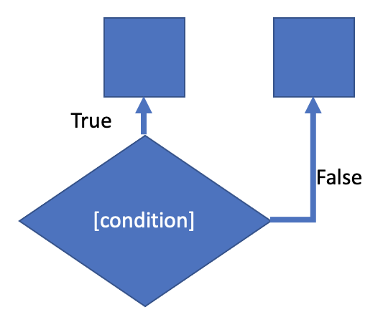
If statements
are to help direct the behavior of a program based on if a certain condition is true or false.
say that it was 7pm and we were deciding between studying for our exam based on if we needed to or not.
If we needed to study, then we would open our flashcard app and start doing flashcards!
Otherwise, if we didn’t need to study, we would go do something else.
We use conditionals to determine what behavior our program should undertake. In our example, we wouldn’t want to study even if we didn’t need to.
The structure of conditionals is based on the if, then, else paradigm.
If we needed to study, then we will study, else we will not study.
If the condition that we are testing is true, then we will do something. If it is false, then we will do something else.

Slide 34
If statements
# Create two int variables myint = 5 myint2 = 4
# Check to see whether myint is greater than, less than, or equal to myint2
if myint > myint2: print("myint1 is greater than myint2!") elif myint < myint2: print("myint1 is less than myint2!") else: print("myint1 and myint2 are equal!")

Slide 35
If statements
3 main operators used when working with conditionals.
> (greater than)
< (less than)
== (equal to)
By adding an equals sign to the end of the greater than or less than operator we can check to see if something is greater than or equal to or less than or equal to something else.
Notice that to check for equivalence, we use the double equal sign instead of the single equal sign.
This is done since the single equal sign is used for assignment of variables. If we were to use the single equal sign for comparison as well, python would have a hard time knowing when we were trying to store information and when we were trying to compare information!

Slide 36
If statements
Other important key words for conditions in python are as follows.
in
and
or
not
In is primarily used when checking to see if some element is in a data structure variable such as a string, list, or tuple

Slide 37
If statements
Other important key words for conditions in python are as follows.
in
and
or
not
In is primarily used when checking to see if some element is in a data structure variable such as a string, list, or tuple

Slide 38
If statements
# Create a list mylist = [1,2,3,4,5,73,6,24,673] if 5 in mylist: print("5 is in the list!")

Slide 39
If statements
And and or allow for the creation of compound clauses
And checks to see if two conditions are both true.
If both conditions are true, the entire statement evaluates to true. Otherwise, the entire statement will evaluate to false.
Or on the other hand, checks to see if at least one condition is true. If at least one condition is met, the entire statement will evaluate to true.

Slide 40
If statements
myint1 = 10 myint2 = 20 myint3 = 30
if myint1 > myint2 and myint1 > myint3: print("myint1 is the greatest")
if myint1 > myint2 or myint1 > myint3: print("myint1 is not the least, but might not be the greatest."

Slide 41
If statements
A shorthand for not equals can be achieved by using the != symbol as shown in the following example
if 5!=10: print("5 is obviously not equal to 10!")

Slide 42
Catching exceptions

Slide 43
Why we need it?
User / you may enter wrong information
System or network failure
Get wrong information
Being feed on purpose
Looking for wrong information
All this and more would cause your program to crash do to error.
Notes:
An exception can be a string, a class or an object.
Most of the exceptions that the Python core raises are classes, with an argument that is an instance of the class.
Note: In order to catch an exception, an "except" clause must refer to the same exception thrown either class object or simple string.

Slide 44
How to catch these errors?
Use try, except, finally
try:
code you are trying to execute or test
except:
code that you do if code could not execute
finally: # not required
code that will run even if code would crash.
Notes:
try: You do your operations here; ......................
except ExceptionI:
If there is ExceptionI, then execute this block.
except ExceptionII:
If there is ExceptionII, then execute this block. ......................
else: If there is no exception then execute this block.
Here are few important points about the above-mentioned syntax −
A single try statement can have multiple except statements. This is useful when the try block contains statements that may throw different types of exceptions.
You can also provide a generic except clause, which handles any exception.
After the except clause(s), you can include an else-clause. The code in the else-block executes if the code in the try: block does not raise an exception.
The else-block is a good place for code that does not need the try: block's protection.

Slide 45
while loop with exception catch
try:
intNum = 0
user_input = input("add numbers? 'y or Y to enter a number':")
# loops that adds numbers as user wants to
while user_input=='y' or user_input=='Y':
intNum += float(input('Enter number'))
user_input = input("add another number?")
except:
print(“Invalid User Entry”)
finally:
print("total of numbers is", intNum)
Notes:
Could find other options on the internet. Recommend to look for your self.
Finally is not required. Could have multiple excepts, each for different error from application results.
Errors include ValueError, RuntimeError, TypeError, and NameError.

Slide 46
Function
Notes:
Functions are an essential part of the Python programming language: you might have already encountered and used some of the many fantastic functions that are built-in in the Python language or that come with its library ecosystem.
However, as a Data Scientist, you’ll constantly need to write your own functions to solve problems that your data poses to you.
There are three types of functions in Python:
Built-in functions, such as help() to ask for help, min() to get the minimum value, print() to print an object to the terminal,… You can find an overview with more of these functions here.
User-Defined Functions (UDFs), which are functions that users create to help them out; And
Anonymous functions, which are also called lambda functions because they are not declared with the standard def keyword.

Slide 47
Function
Is a block of organized and reusable code that serves to perform a single, related action.
When to use a function?
Have code or similar code that you would use more than once
Code is more readable, by giving a name to a group of Python statements.

Slide 48
Function
Functions are declared with def keyword and given a name
Assigned parameter(s) that method needs
Could be none, one, or multiple
Can return information with return keyword
Exits once the return is implemented in am if statement.

Slide 49
Function example 1
def fnSay_Hello(xname):
print("Hello",xname)
# call the function
fnSay_Hello("Fanshawe College")
Results: Hello Fanshawe College is printed.
This function prints a string and does not returns anything
Calling a function must come after it has been created.

Slide 50
Function example 2
def fnSum(a,b,c):
xSum = a + b + c
return xSum
def fnAvg(num1, num2):
return (num1 + num2)/2
# call the functions
sumValue1 = fnSum(4,7,9) # value = 20
sumValue2 = fnSum(2,7,5) # value = 14
# value = 17
print("Average",fnAvg(sumValue1, sumValue2))
Notes:
sum function is called twice and return values are saved in a variable.
Than, the variables are used in the avg_num function called in the print function to print the average.

Slide 51
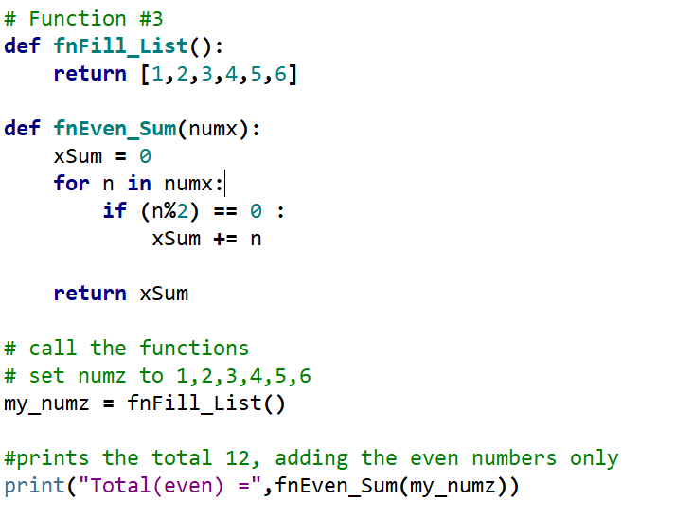
Function example 3
Notes:
This is to show that you could put if statements, loops, or any other type of coding you would like or need.

Slide 52
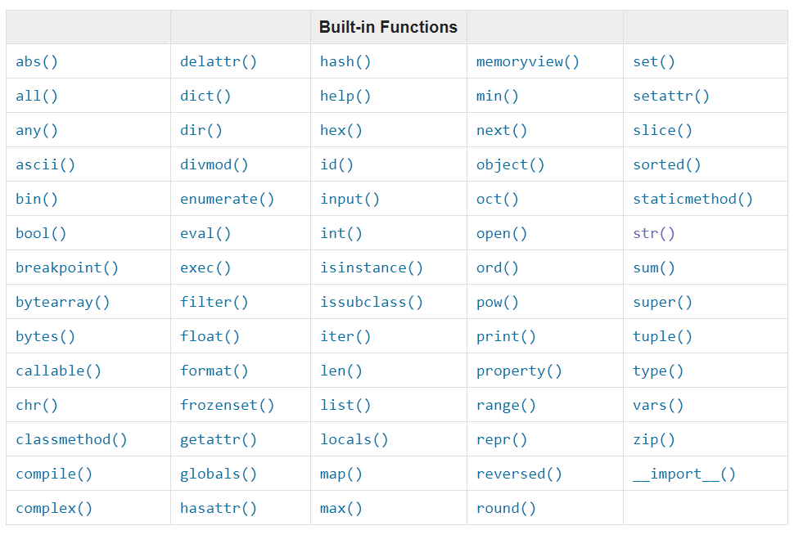
Build-in functions
Source: https://docs.python.org/3.7/library/functions.html
Notes:
Build in functions in python. We have used input(), int(), float()
Could read about them in the source link.
We will use some of these throughout the course.

Slide 53
Build in function
Build in functions in python. We have used input(), int(), float()
Could read about them in the source link.
We will use some of these throughout the course.
Side note:
Objects - like lists, strings, floats, and int- have their special methods connected to them.
word = "test"
word.upper() will turn “test” to “TEST”

Slide 54
Import & Modules
Notes:
If you quit from the Python interpreter and enter it again, the definitions you have made (functions and variables) are lost. Therefore, if you want to write a somewhat longer program, you are better off using a text editor to prepare the input for the interpreter and running it with that file as input instead. This is known as creating a script. As your program gets longer, you may want to split it into several files for easier maintenance. You may also want to use a handy function that you’ve written in several programs without copying its definition into each program.
To support this, Python has a way to put definitions in a file and use them in a script or in an interactive instance of the interpreter. Such a file is called a module; definitions from a module can be imported into other modules or into the main module (the collection of variables that you have access to in a script executed at the top level and in calculator mode).
A module is a file containing Python definitions and statements. The file name is the module name with the suffix .py appended. Within a module, the module’s name (as a string) is available as the value of the global variable __name__.

Slide 55
Modules
Module is a file containing Python definitions and statements, including functions and classes.
Name of the module is the name of the file with .py suffix
There are modules that Python provides and you can build your own.
Any Python file you write can be used as a module.
For course purpose we will save or copy modules in the same directory of code we want to run
Notes:
The lab1.py that was written last lab could be used in future code.
If you use the keyword import in future code.

Slide 56
Python file example
#named module_example.py
def square(x)
return x**2
def add(x, y)
return x+y
def sub(x, y)
return x-y

Slide 57
Import
If you wanted to access the functions and variables of module_example in the same directory.
You would use the import keyword
Have three (3) option to do so
import module_example
num_squ = module_example.square(9)
from modile_example import square, add, sub
from modile_example import *
Result = sub(7,5)
Import module_example as me
results = me.add(5,6)
Notes:
from modile_example import * takes all the statements

Slide 58
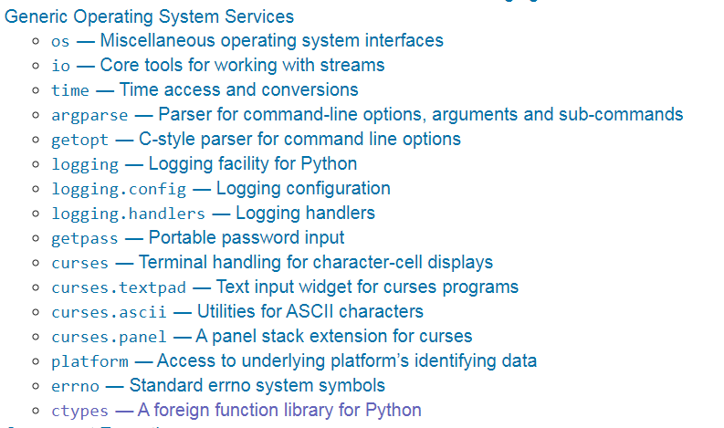
Some Modules provided by Python community
Source: https://docs.python.org/3/library/
Notes:
We will use some of these and maybe others throughout the course

Slide 59
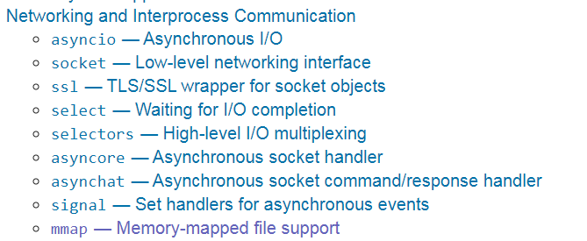
Some Modules provided by Python community
Source: https://docs.python.org/3/library/

